Slide 1
ATM Machine Software
Project Presentation
Submitted by -
UTKARSH SINGH
(2002840100168)

Slide 2
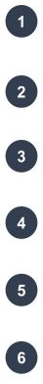
Content
Introduction
Modules Description
Language or technology
Snapshots
References

Slide 3

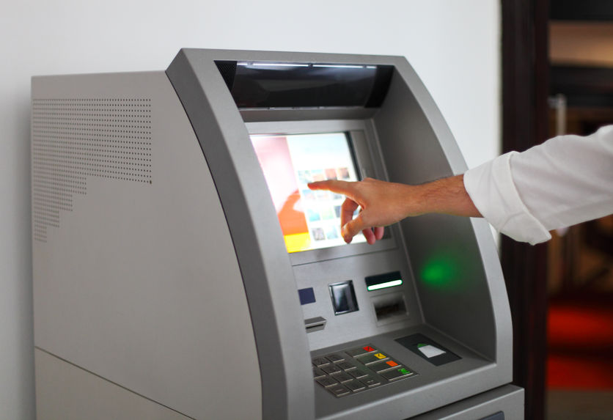
Introduction
The term ATM stands for Automated Teller Machine.
This mini project is based on developing an ATM using “Java Programming Language”.
Here CLI (Command Line Interface) has been used in order to make it user friendly.
By using an ATM we can perform different financial transactions such as cash deposits, withdrawals, etc.

Slide 4
Modules Description
There will be a login window where we enter our id and Password. Then our details will show.
Used scanner function to take input from the user
Used switch case to select the different options

Slide 5
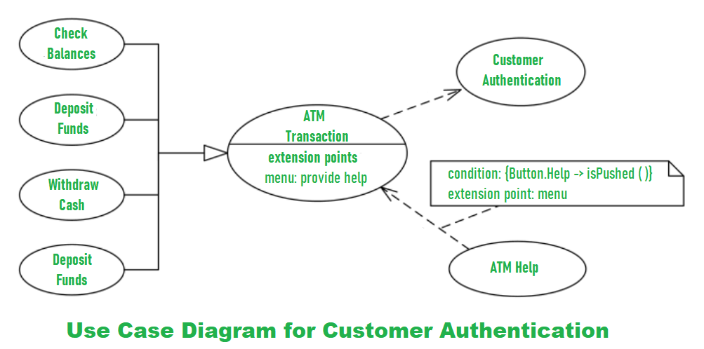
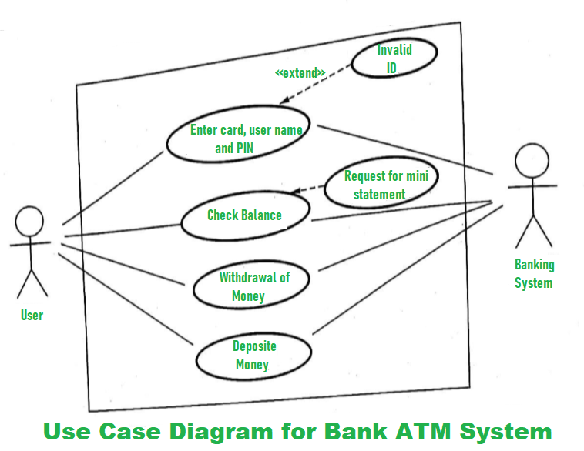
User-Case Diagram
Quotations are commonly printed as a means of inspiration and to invoke philosophical thoughts from the reader.

Slide 6

Language or technology
Language Used:- Java Language is used in this mini project of ATM Machine
System Requirement:-
Applications : Command prompt(or terminal), Notepad
Language : Java
Java Development Kit : jdk1.8
Operating System : Windows,Mac,Linux

Slide 7
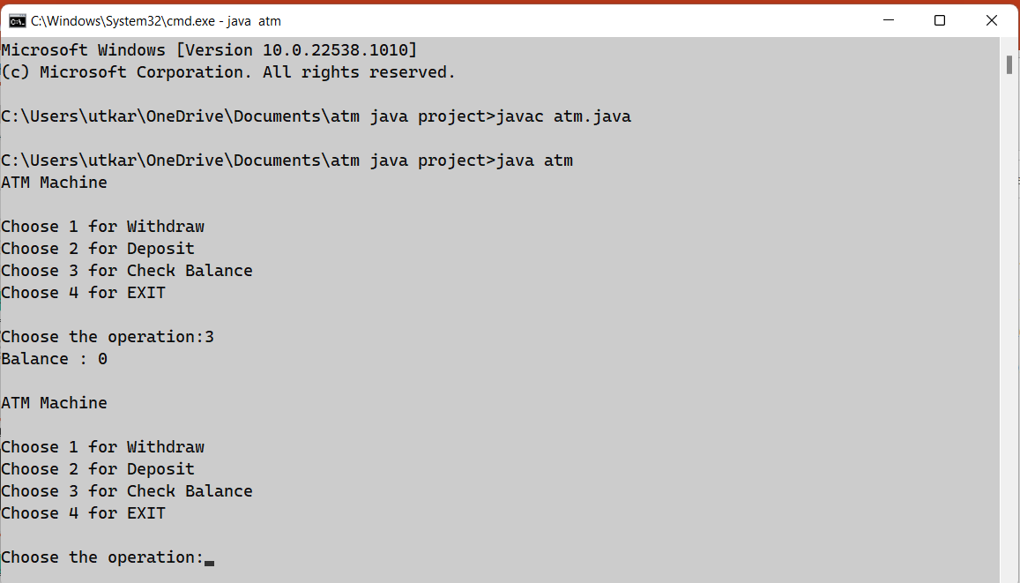
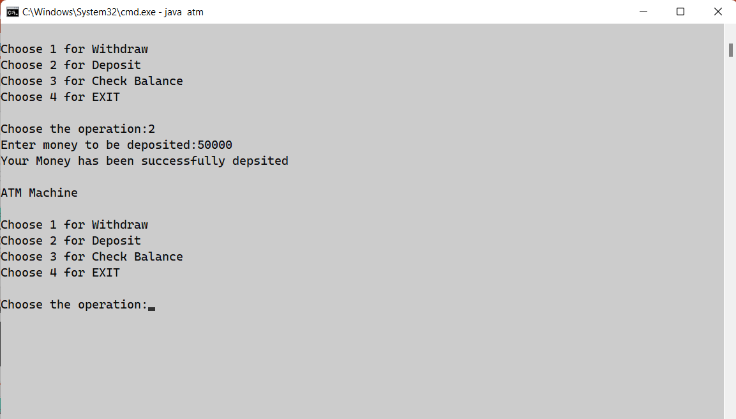
Snapshots

Slide 8
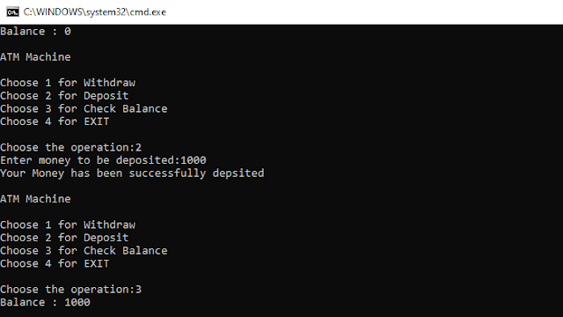

Slide 9
References
WEBSITES:
https://www.elprocus.com/automated-teller-machine-types-working-advantages/
https://www.javacodegeeks.com/
https://pdfcoffee.com/

Slide 10


